Slide 1
Automate Emotion Analysis of Textual comments TCS iON Digital Learning TNSDC RIO – 125 TCS iON Remote Internships Artificial Intelligence and Real world Application
by
PANNEERSELVAM R
Goverment Arts College
Udumelpet

Slide 2
ABSTRACT
Emotion Analysis is a process of identifying and analyzing the underlying emotion expressed in the textual data in the form of sentences. Sentiment analysis is a superset of Emotion Analysis. In sentiment analysis, there are only three results such as positive, negative, and neutral, but in Emotion analysis, we can make up to n number of results. In our Emotion Analysis, we are detecting ten Emotions.Sentiment Analytics tries to understand the general feeling and emotion experienced by a viewer or customer. Whereas emotional analysis uses a complex system to understand consumer responses.

Slide 3
INRTODUCTION
It can be difficult, but it's also important, to identify someone's emotions by analyzing text or data that has been written or expressed by them. This is because matter expressions frequently result not only from the direct use of emotional words, but also from the interpretation of the meaning of ideas and interactions of ideas that are represented within the text of knowledge. Understanding the text's tone is essential for human-computer interactions. To provide the required and accurate result, associate degree RNN LSTM technology may recursively investigate the text knowledge. Feelings can be expressed through anger, surprise, hate, fear, happiness, and a variety of other emotions. because there is no recognised word order for emotions.Despite the considerable effort analysts have made to identify emotions from facial and audio data, the study of emotion recognition through material knowledge is still a vibrant and cutting- edge fiel

Slide 4
DEEP LEARING
Deep learning is a machine learning technique that teaches the computer to do what humans are more likely intended to do. It learns from examples and Deep learning is a key technology for almost all modern problems and inventions such as self-driving cars, where each car sends the information about the road structure everyDeep learning is a machine learning method that instructs computers to perform actions that people are more inclined to execute. Deep learning is a fundamental technique for the majority of contemporary issues and innovations, including self-driving automobiles, in which each vehicle transmits information about the road network every mile, which is subsequently used as training data for further development. known as picking up knowledge via examples. network, deep learning employs a multi-layer strategy.

Slide 5
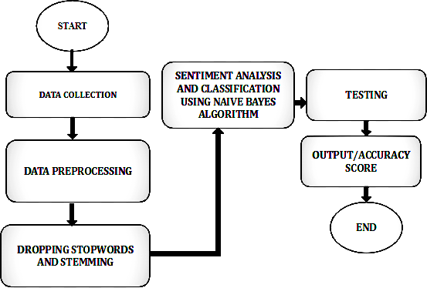
FLOW DIAGRAM

Slide 6
PROPOSED METHODOLOGY
The above diagram represents the block diagram of the proposed system. It shows how the input dataset is processed and how the preprocessing works. In feature Extraction, the
Word embedding is done. In model development, we deploy our RNN algorithm to get the desired result, and then we assess our model with the existing model to evaluate the performance and calculate the performance improvement.

Slide 7
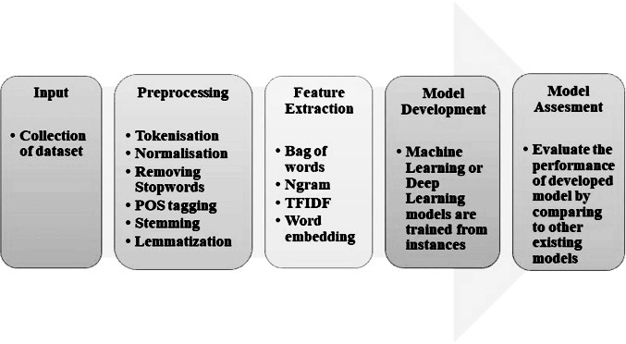
Emotion detection system

Slide 8
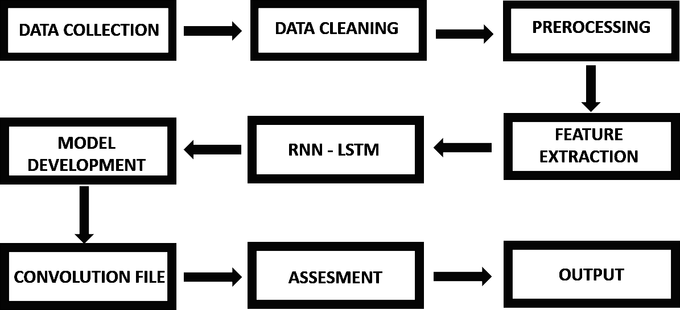
Algorithm Emotion detection

Slide 9
shows the Emotion detection flow design that comprises Data collection and cleaning and preprocessing by cleaning stopwords, symbols, and user handles. Then Feature extraction using TF and IDF and then using Recurrent neural network (Long Short term Memory) to create our convolution file and then assess our project and optimize the system.

Slide 10
The steps to be followed in design flow of emotion detection,
i. Emotion analysis is a Natural Language Processing(NLP) technique used to determine a person’s state of things
ii. Collected dataset and preprocessed by cleaning user handles, symbols, and stop words using neattext functions
iii. Tokenize the data into words and sentences and then Feature extraction like word embedding, Bag of words, and TF-IDF is done.
iv. Used count vectorizer for counting the tokens/words
v. Used RNN and CNN techniques to predict the Emotion recursively
vi. Used LSTM ( Long Short Term Memory) from RNN
vii. It is a recurrent model and can remember and regulate values over arbitrary time intervals. It is more useful for predictions.
viii. Created a convolutional file and calculated the accuracy
ix. Used the convolutional file for the detection process.

Slide 11
RESULTS AND DISCUSSION
Confusion matrix, accuracy, precision, and recall metrics were used to gauge the model's performance. RNN models were used to carry out various tasks with the various datasets shown above, and feature extraction was used to assess how those computations were
presented. It also displays recall and precision for reference since F-score is derived from these two metrics.After training of 50000 sentence review. The accuracy range of the system ranges above 85 percent and the convolutional weight file’s size ranges around 250 MB as shown in

Slide 12
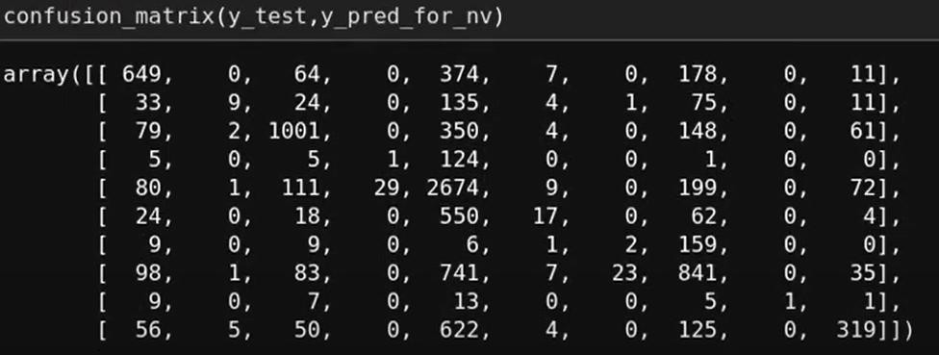
RESULTS AND DISCUSSION

Slide 13
There are nine classes in Emotion detection system,
● Happy
● Surprise
●Fear
● Neutral
● Anger
● Sad
● Joy
● Shame
● Not satisfied

Slide 14
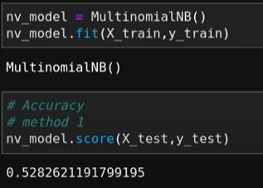

RESULTS AND DISCUSSION

Slide 15
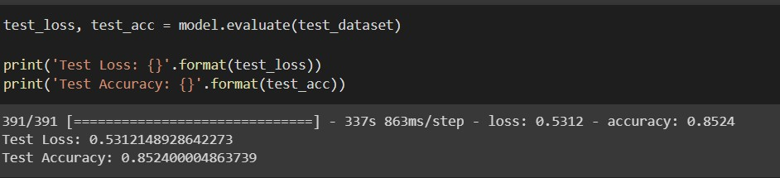
RESULTS AND DISCUSSION

Slide 16
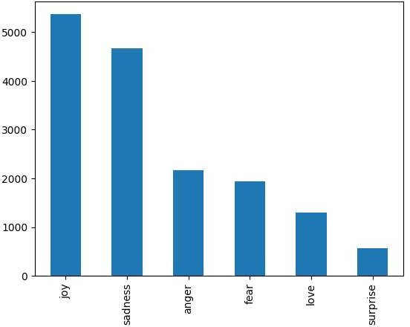
OUTPUT:
Emotios

Slide 17
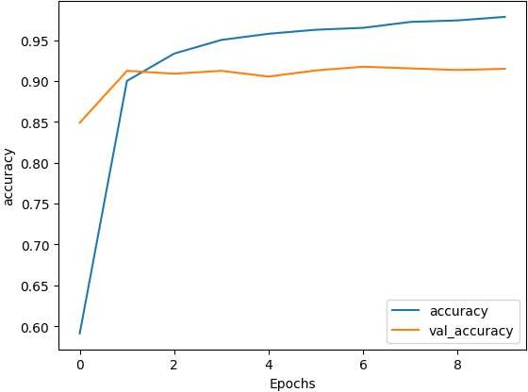
ACCURACY

Slide 18

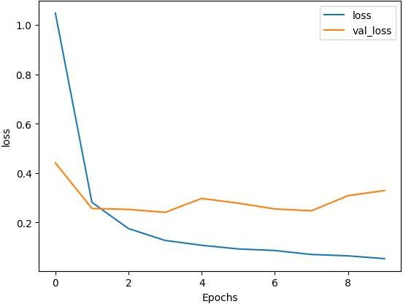

Slide 19
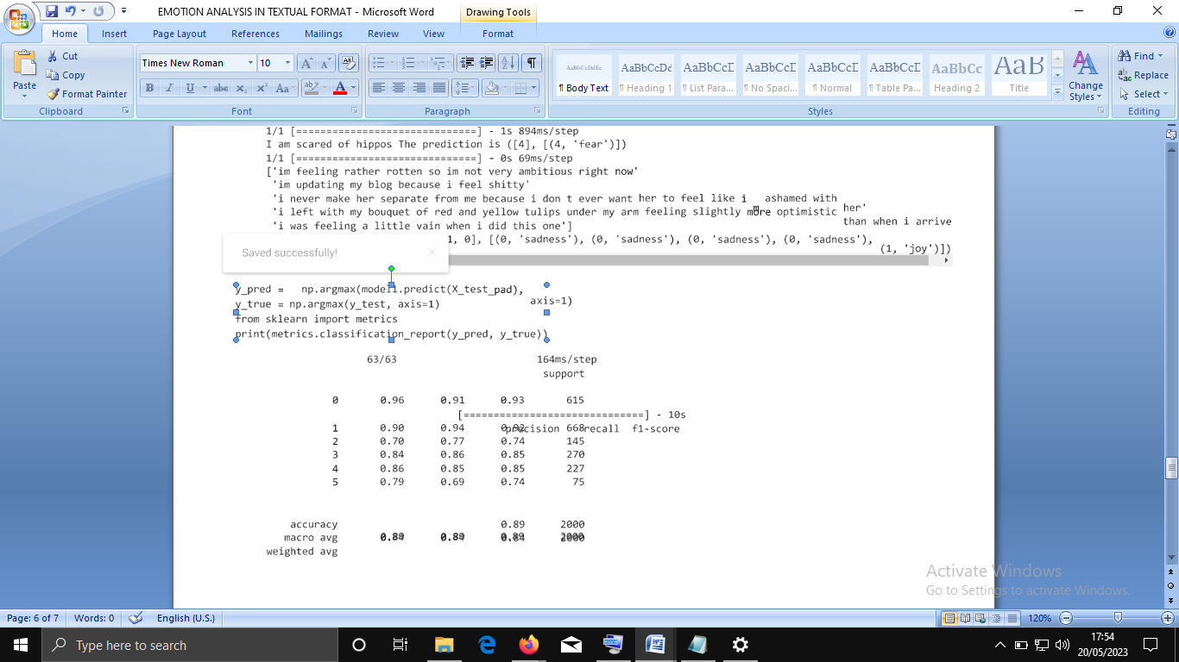
OUTPUT:

Slide 20
CONCLUSION
The main aim of Automated Detection of Emotion is to create an Emotion-based review system, predict Emotions from textual data and generate a product review system.The performance and accuracy of machine learning algorithms and deep learning algorithms depend on the pre-processing and size of the dataset. Many of the algorithms are not persistent but the RNN LSTM model is prevalent in emotion analysis. But also, lexicon and ML- based approaches are also evolving and getting better.

